Slide 1
Automatic Grading of Mathematical Drawings from O/L Exam Answers
Diunuge Buddhika Wijesinghe
Supervisors: Dr. Surangika Ranathunga, Prof. Gihan Dias

Slide 2
Introduction
O/L Exam is a major turning point of life
40%-50% Students fail Mathematics
O/L Mathematics is identified as a subject which needs “Special Attention” by Ministry of Education
“Making Mathematics a favorite Subject” is a educational goal of 2013 (Annual performance report, 2013, Ministry of Education)

Slide 3
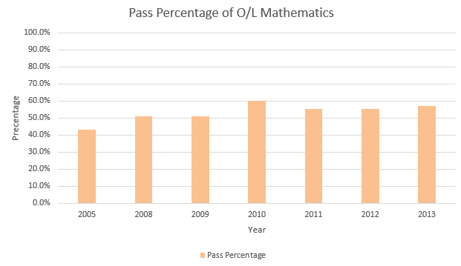
Pass Percentage of O/L Mathematics

Slide 4
Practicing for exam is important!
Manual marking capacity of teachers is limited
An automatic grading system capable of providing quick feedback on practice exam answers is important
Required to have a good feedback system to evaluate student answers
Diagram Grading is not significantly addressed
Notes:
Practicing for an exam is one of the main things to be successful in exams. Students who sit for major examinations such as GCE Ordinary Level in Sri Lanka should practice for exams using past papers. When practicing it is required to have a good feedback system to evaluate student answers. Since manual marking capacity of teachers is limited, an automatic grading system capable of providing quick feedback on practice exam answers would be highly useful [1], both to students and teachers. Currently, auto grading is somewhat limited to MCQ answers since evaluating MCQ answers are pretty much straight forward.

Slide 5
Diagrams in the O/L Mathematics Paper
Cartesian Graphs
Venn Diagrams
Geometrical Drawings
Trigonometry Drawings
Notes:
Histograms
Custom drawings

Slide 6
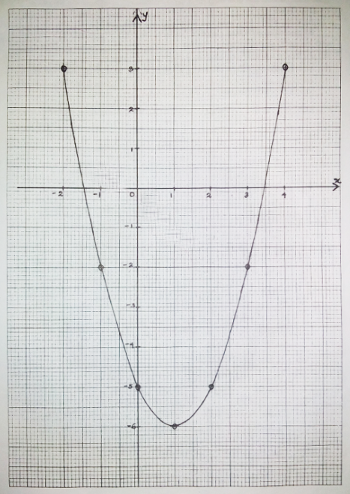
Diagrams in the O/L Mathematics Paper
Cartesian Graphs
Venn Diagrams
Geometrical Drawings
Trigonometry Drawings
Regular type of question
Required to draw on a given graph sheet
Evaluation focuses on the scale, data point and the shape of the graph
Notes:
Histograms
Custom drawings

Slide 7
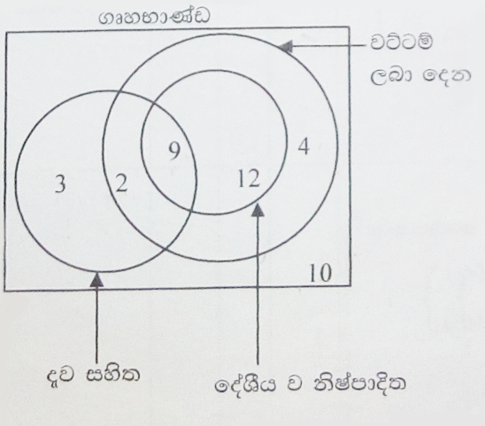
Diagrams in the O/L Mathematics Paper
Cartesian Graphs
Venn Diagrams
Geometrical Drawings
Trigonometry Drawings
Regular type of question
Drawn on regular answer sheet
Evaluation focuses on proper indication of elements
May contain steps
Notes:
Histograms
Custom drawings

Slide 8
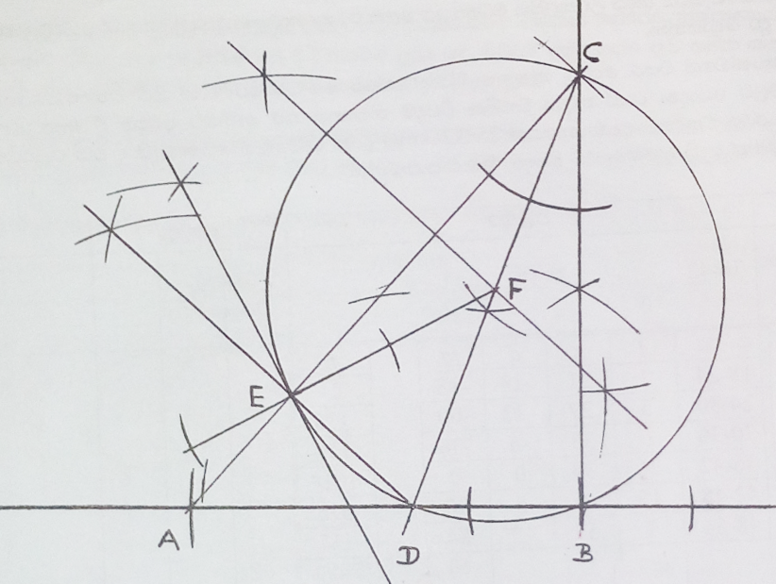
Diagrams in the O/L Mathematics Paper
Cartesian Graphs
Venn Diagrams
Geometrical Drawings
Trigonometry Drawings
Regular question
Required to draw with pencil, ruler and pencil compass
Evaluation focuses on the scaling, drawing procedure
Notes:
Histograms
Custom drawings

Slide 9
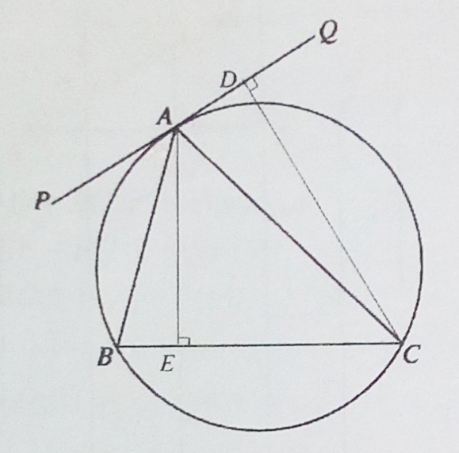
Diagrams in the O/L Mathematics Paper
Cartesian Graphs
Venn Diagrams
Geometrical Drawings
Trigonometry Drawings
Not a regular question
Depends on the exam year
Evaluation process also depends on the question
Notes:
Histograms
Custom drawings

Slide 10
Objectives
Identify and parse diagrams which provided as answers in O/L mathematics
Evaluate the given answers with respect to marking scheme
Provide feedback to the student

Slide 11
Research Scope
Parse Mathematical Drawings appearing in O/L context which are Vector Images
Venn Diagrams
Cartesian Graphs
Geometrical Drawings
Develop Automatic Evaluation Method for above diagrams
Develop a Feedback System

Slide 12
Progress
First progress review
Literature Review of Venn Diagrams
Venn Diagram Parsing
2nd Progress Review
Venn Diagram Assessment
Cartesian Diagram Parsing
Cartesian Diagram Assessment
Diagram Type | Parsing | Evaluation & Feedback
Venn | Completed | Completed
Cartesian | Completed | Started, Not Completed
Geometric | Not Started | Not Started

Slide 13
Literature Review
Futrelle et al.(1992,1995)[1,2] presented a diagram understanding system based on graphics constraint grammars to recognize x-y data graphs and gene diagrams
Biological Knowledge Laboratory, Northeastern University
Handled Raster Images
Proposed a constraint based grammar for parsing
Discussed efficient parsing of graphs
Spatial Indexing for efficient parsing
Experimented only for x-y graphs and gene diagrams

Slide 14
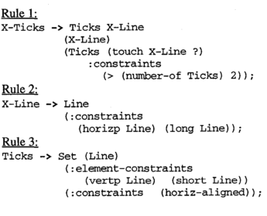
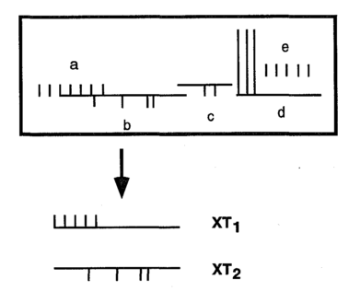
Literature Review Contd.
A diagram with 24 lines in the a-e portion which yields two X-Tick structures, XT1 and XT2. according to the grammar

Slide 15
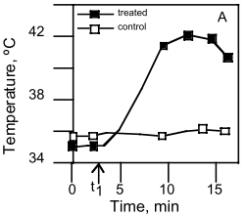
Literature Review Contd.
Futrelle (1999)[3] discussed the ambiguity theory of visual languages and it’s role in diagram parsing
Whenever broad coverage grammars are built to parse a wide range of objects, the grammars will over-generate, giving multiple parses, introducing ambiguities
Common Ambiguities
Lexical ambiguity
Attachment ambiguity
Gaps
Analytic ambiguities
Role determination
Composition
Segmentation & Occlusion

Slide 16
Literature Review Contd.
Huang and Tan(2005,2007)[4,5] proposed a model-based approach for recognizing several commonly used types of chart image
System is developed to handle raster images
Textual Information Extraction is introduced with machine learning approach
Introduced a grammar for chart images
Only for chart types such as line charts, bar charts
Discussed application of the system

Slide 17
Literature Review Contd.
Richard et al.(1986)[6] discussed the usage of Venn Diagrams in teaching and testing
Journal Article appeared in “Science Education”
Use of Venn Diagrams as a mode of Understanding, both in research and classroom practice.
Discussed the student response variations for a Venn Diagram question
Notes:
Eular Diagrams -> no empty intersections

Slide 18
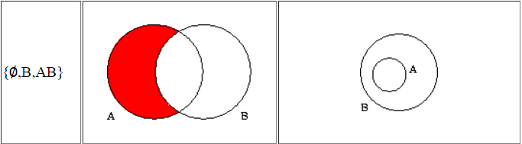
Literature Review Contd.
Ruskey and Weston (1997)[7] have done a survey of Venn Diagrams
Discussed the theory related to Venn Diagrams including definitions, representations and similarity.
Generalization and relations to Euler Diagrams
Notes:
Eular Diagrams -> no empty intersections

Slide 19
Literature Summary
Recognition and understanding of diagrams is a relatively new research field
Most of these previous work studied the commonly used diagrams which are charts (bar charts, pie charts or line charts) & graphs.
These works focused on recognizing and understanding individual infographic images, but not the grading
Most of them ignore the textual information
No existing tutoring system provides auto grading capability for mathematics diagrams

Slide 20
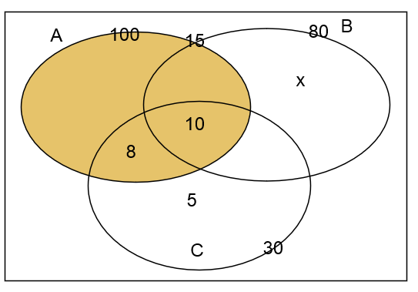
Auto-grading Venn Diagrams
Experiments started with Venn Diagram
Relatively less complex
Steps
Parse SVG Image
Build a XML with Venn Data
Evaluate the Diagram according to the marking scheme

Slide 21
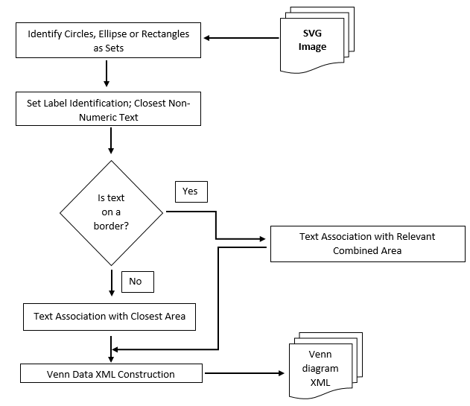
Venn Data Parsing
Close distance parameters are tuned with reference to minimal font size of a image
Text-area association are depend of the centroid, size of the area and the text location

Slide 22
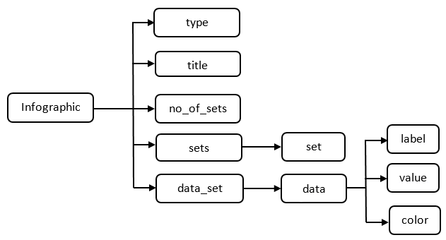
Venn Data Parsing Contd.
Venn Data Structure
Venn Diagram in SVG file format

Slide 23
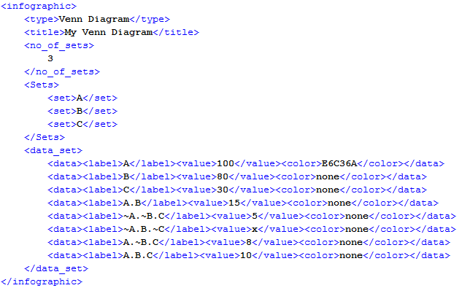
Venn Data Parsing Contd.
Venn Diagram after parsing
Venn Diagram in SVG file format

Slide 24
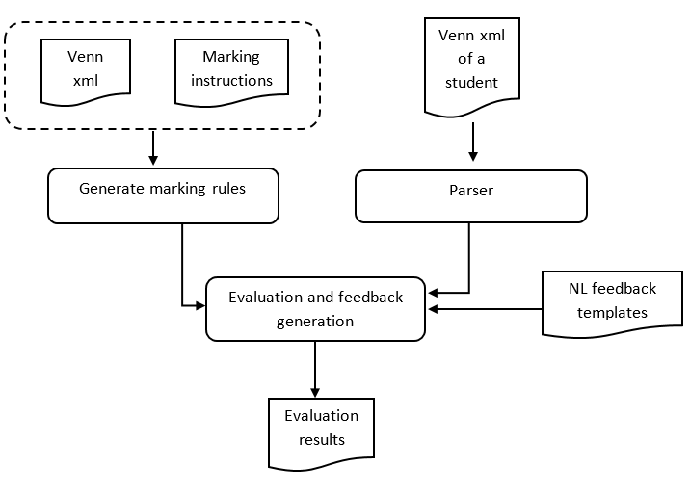
Evaluation
Evaluation model

Slide 25
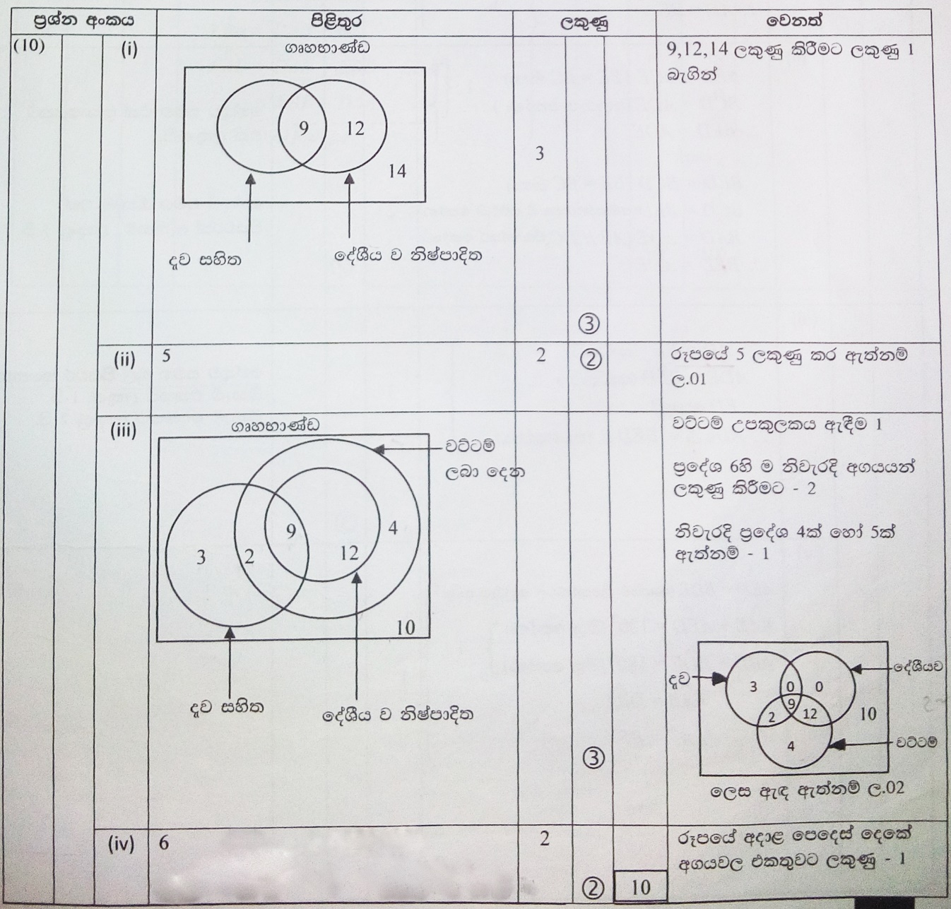
Evaluation Contd.
Marking scheme integration
Marking criteria depends on the question
General patterns
One to one match
Required compulsory details
Required optional details
Partial marks
Alternative diagrams

Slide 26
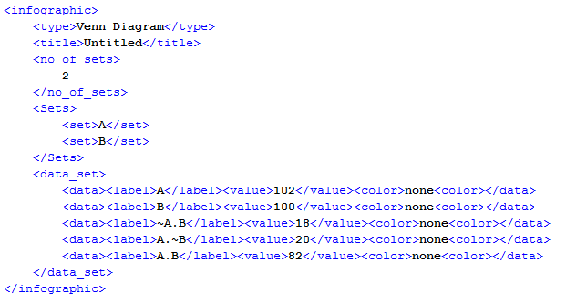
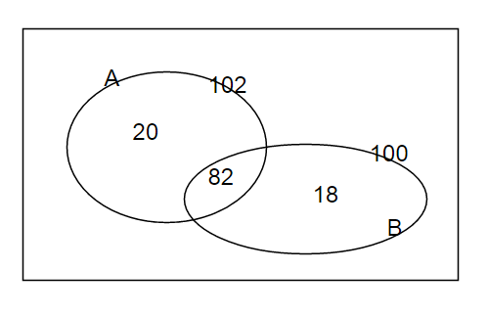
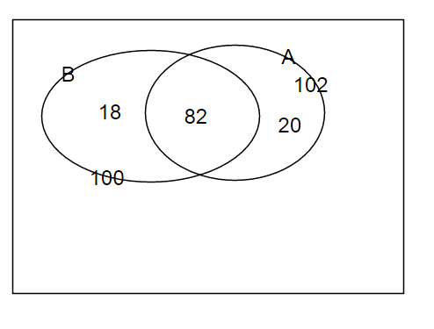
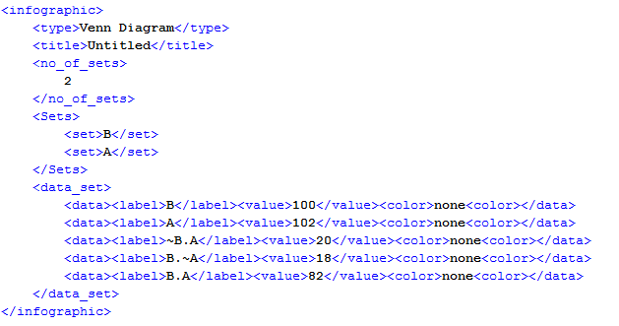
Evaluation Contd.
Two answers for O/L Venn Diagram Question in 2000
Notes:
We can do one to one matching

Slide 27
Research Progress
Studied the existing literature & Identified the research scope
Analyzed current graphs and marking procedure on O/L context
Proposed a grammar for Venn Diagrams
Researched Venn Diagram Interpretation and evaluation
Collected a testing data set

Slide 28
Future Work
Improve Diagram Parsing
Marking Scheme integration to the Cartesian Diagram Evaluation
Parsing and Evaluation of remaining diagram type
Geometric Drawings
Diagram Type | Parsing | Evaluation & Feedback
Venn | Completed | Completed
Cartesian | Completed | Started, Not Completed
Geometric | Not Started | Not Started

Slide 29
References
Futrelle, R. P., Kakadiaris, I., Alexander, J., Carriero, C. M., Nikolakis, N., & Futrelle, J. M. (1992). Understanding diagrams in technical documents, IEEE Computer, Vol. 25(7), pp. 75-78.
Futrelle, R. P., & Nikolakis, N. (1995, August). Efficient analysis of complex diagrams using constraint-based parsing. In Document Analysis and Recognition, 1995., Proceedings of the Third International Conference on(Vol. 2, pp. 782-790). IEEE.
R. Futrelle, Ambiguity in visual language theory and its role in diagram parsing, Proceedings 1999 IEEE Symposium on Visual Languages, 1999

Slide 30
References Contd.
Huang, W., Tan, C. L., & Leow, W. K. (2005, August). Associating text and graphics for scientific chart understanding. In Document Analysis and Recognition, 2005. Proceedings. Eighth International Conference on (pp. 580-584). IEEE.
W. Huang, C. Tan, A System for Understanding Imaged Infographics and Its Applications, Proceedings of the 2007 ACM symposium on Document engineering - DocEng '07, 2007`
Gunstone, R. F., & White, R. T. (1986). Assessing understanding by means of Venn diagrams. Science Education, 70(2), 151-158.

Slide 31
References Contd.
Ruskey, F., & Weston, M.,A survey of Venn diagrams, Electronic Journal of Combinatorics 4. 1997 http://emis.matem.unam.mx/journals/EJC/Surveys/ds5/VennEJC.html

Slide 32
Thank You!

